Slide 1
PAS PRAKTEK MEMBUAT APLIKASI SISTEM INFORMASI DATA COVID-19 SMK NEGERI 9 SEMARANG
Nama : Alfarizky M P W Kelas : XI RPL Absen : 03

Slide 2
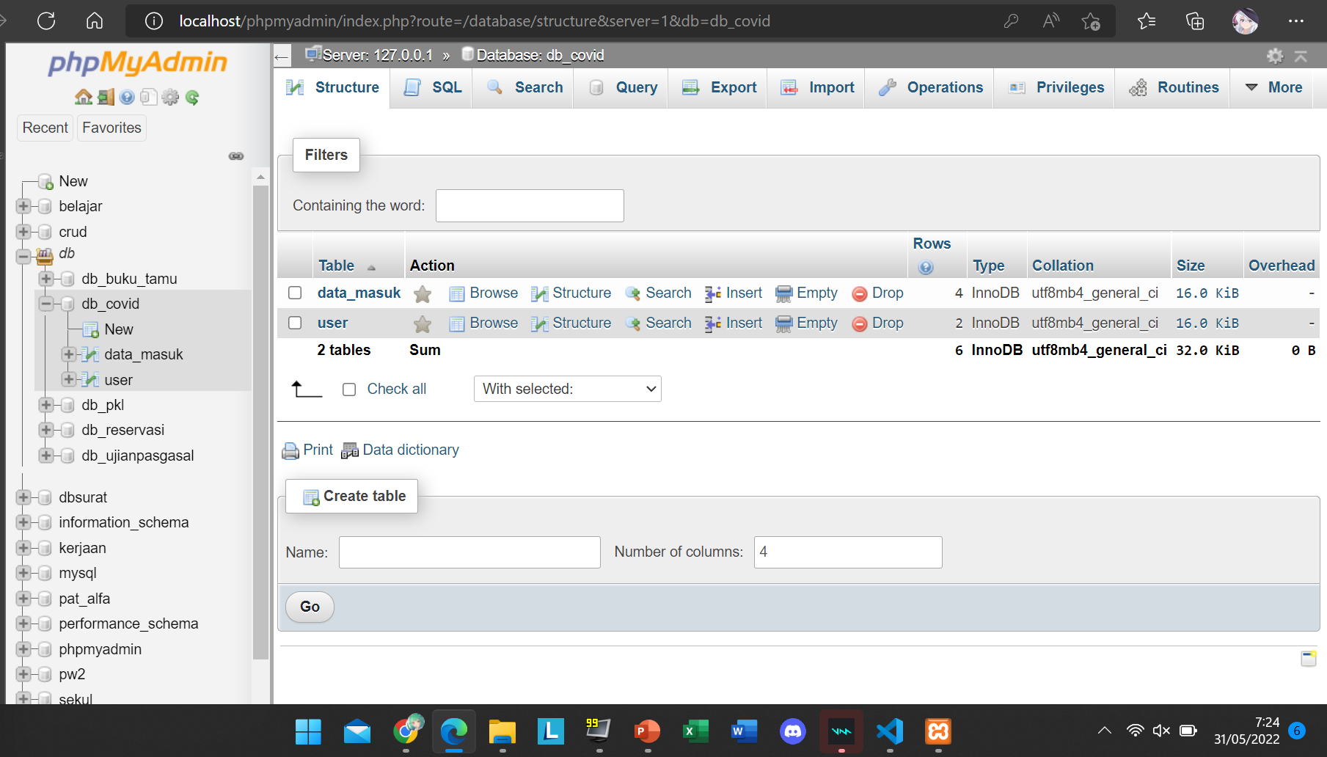
TAMPILAN DATABASE

Slide 3
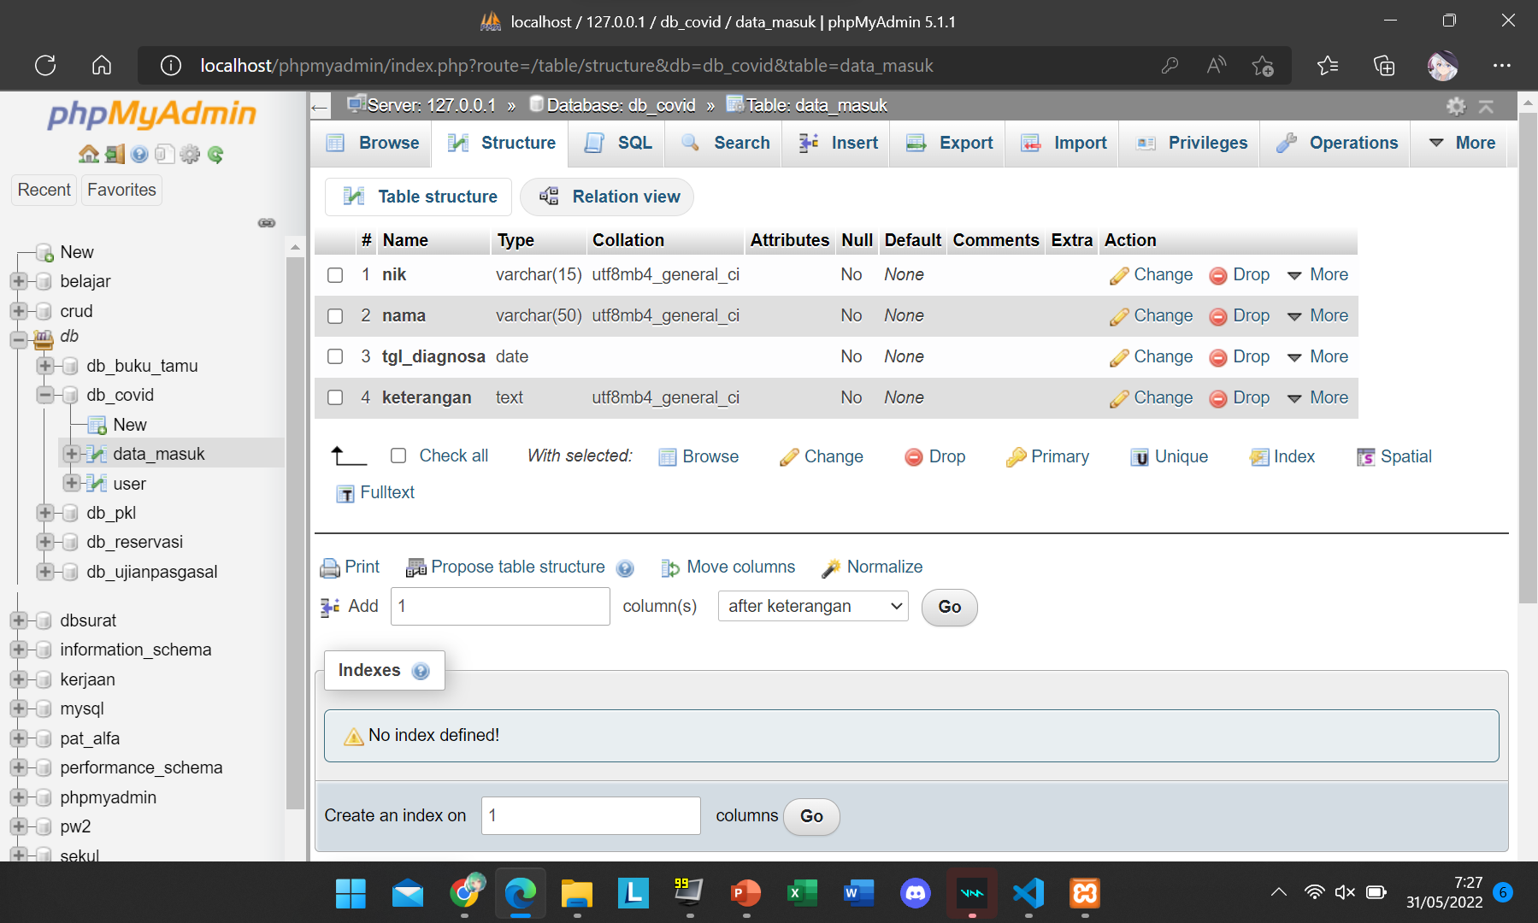
TAMPILAN TABEL DATA MASUK

Slide 4
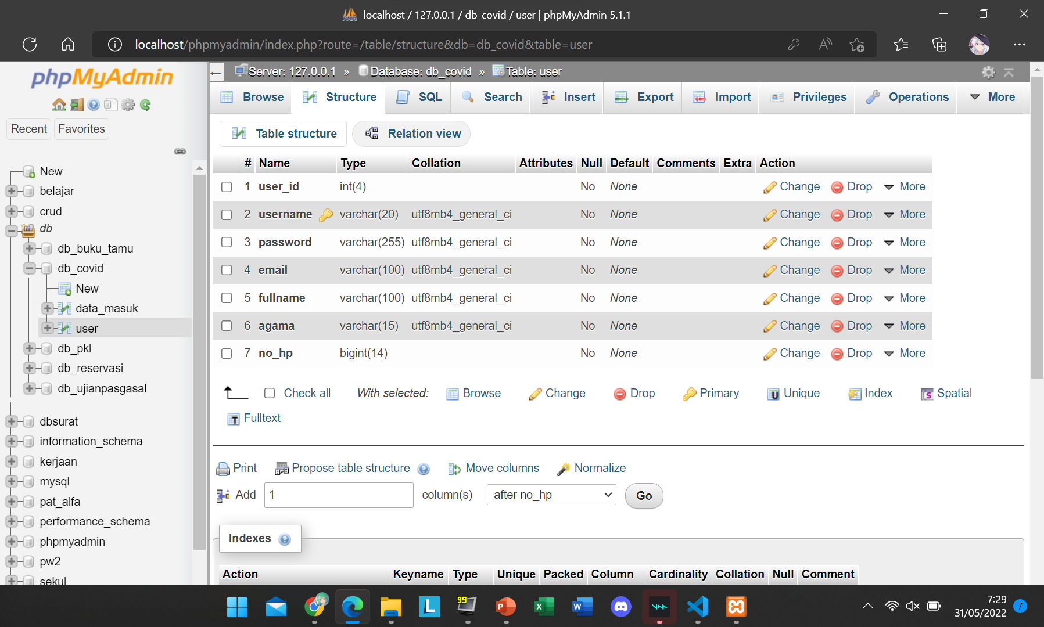
TAMPILAN TABEL USER

Slide 5
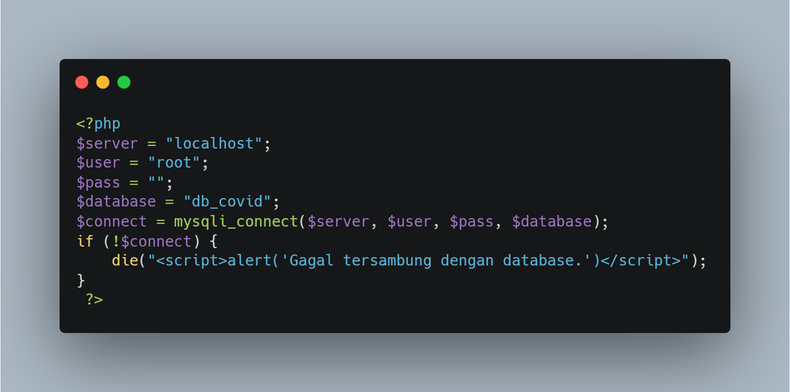
KONEKSINYA

Slide 6
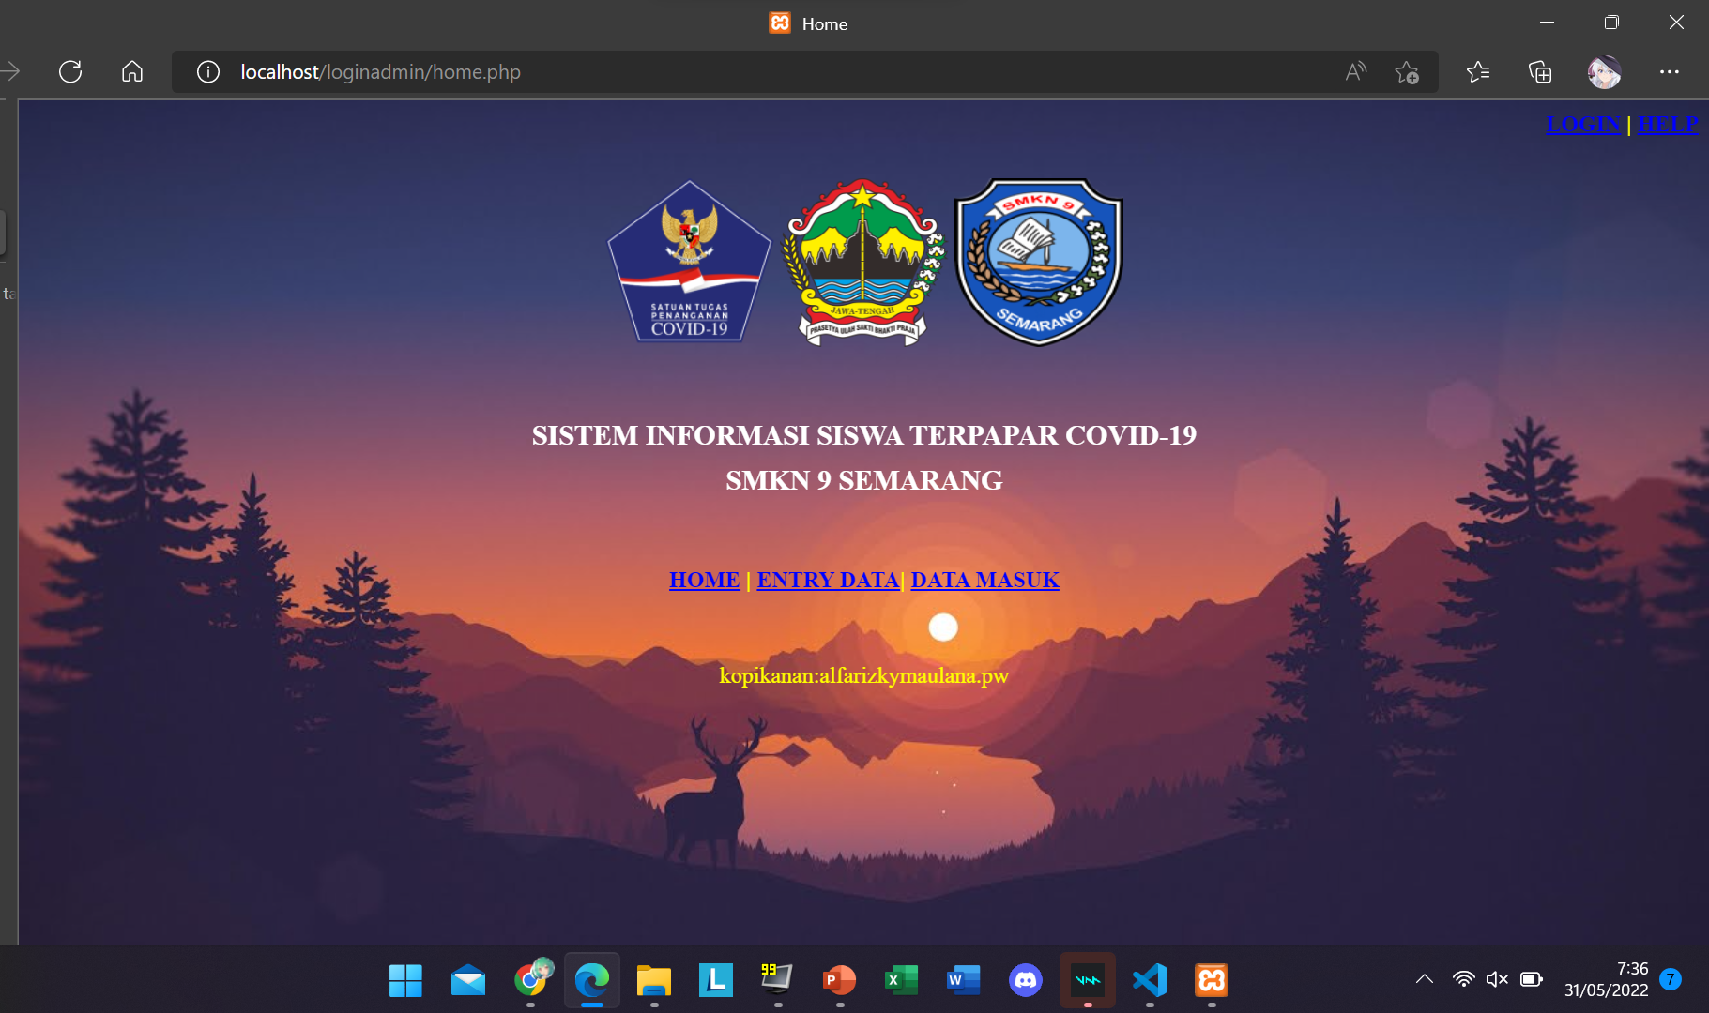
TAMPILAN HOME

Slide 7
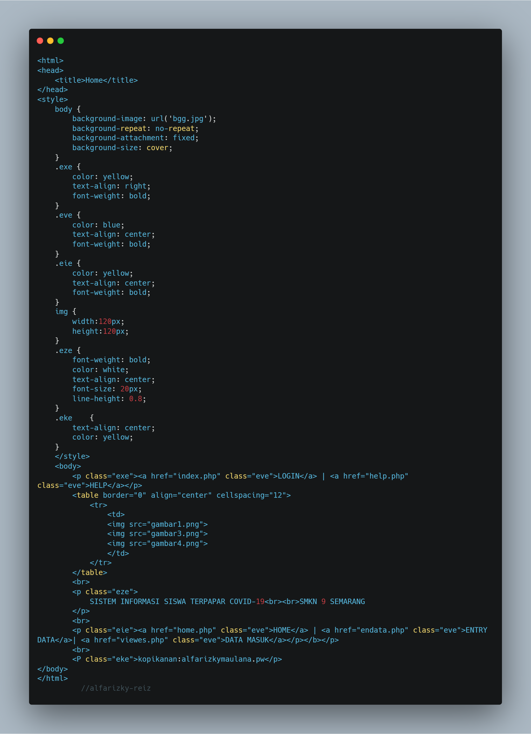
SCRIPT HOME

Slide 8
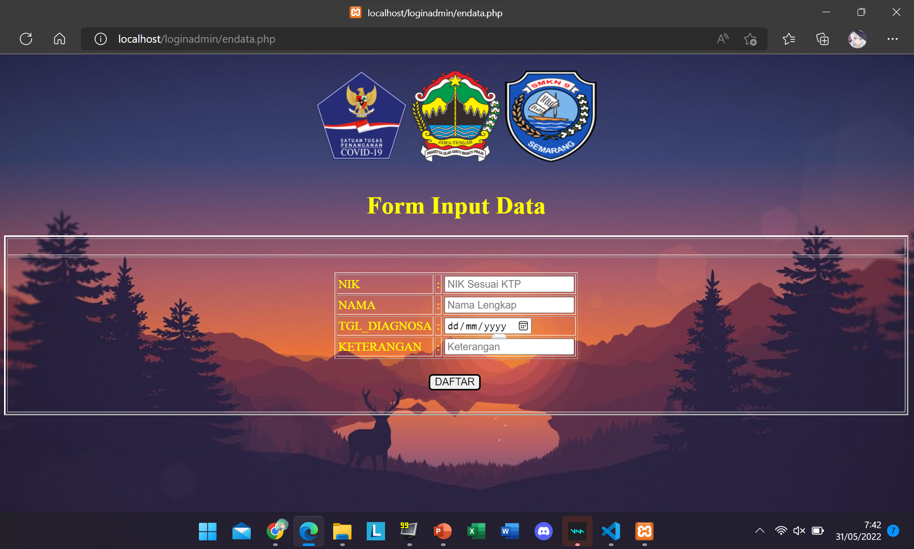
TAMPILAN ENTRY-DATA COVID

Slide 9
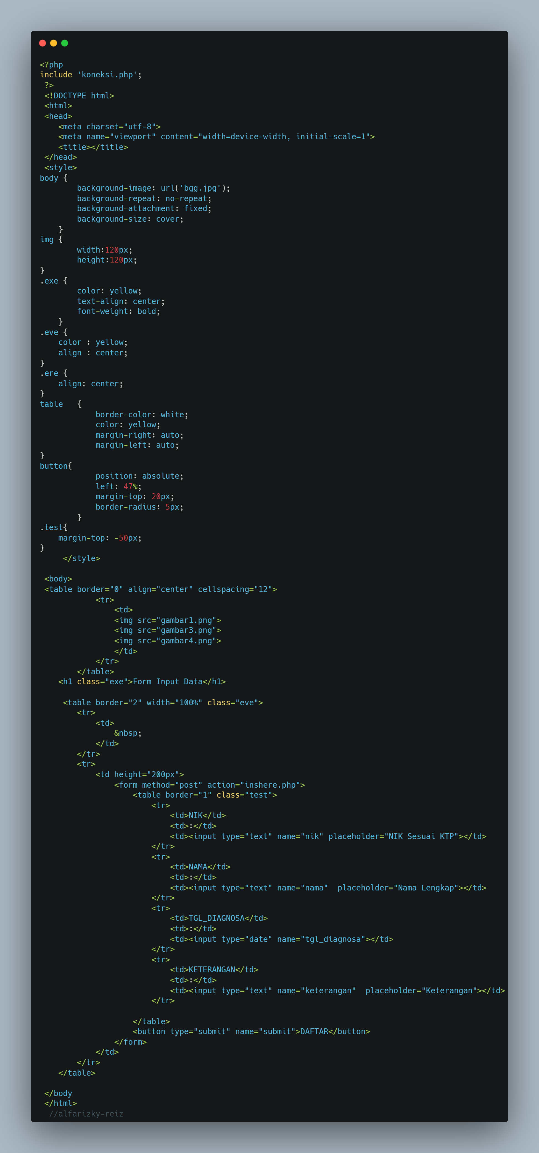
SCRIPT ENTRY-DATA COVID

Slide 10
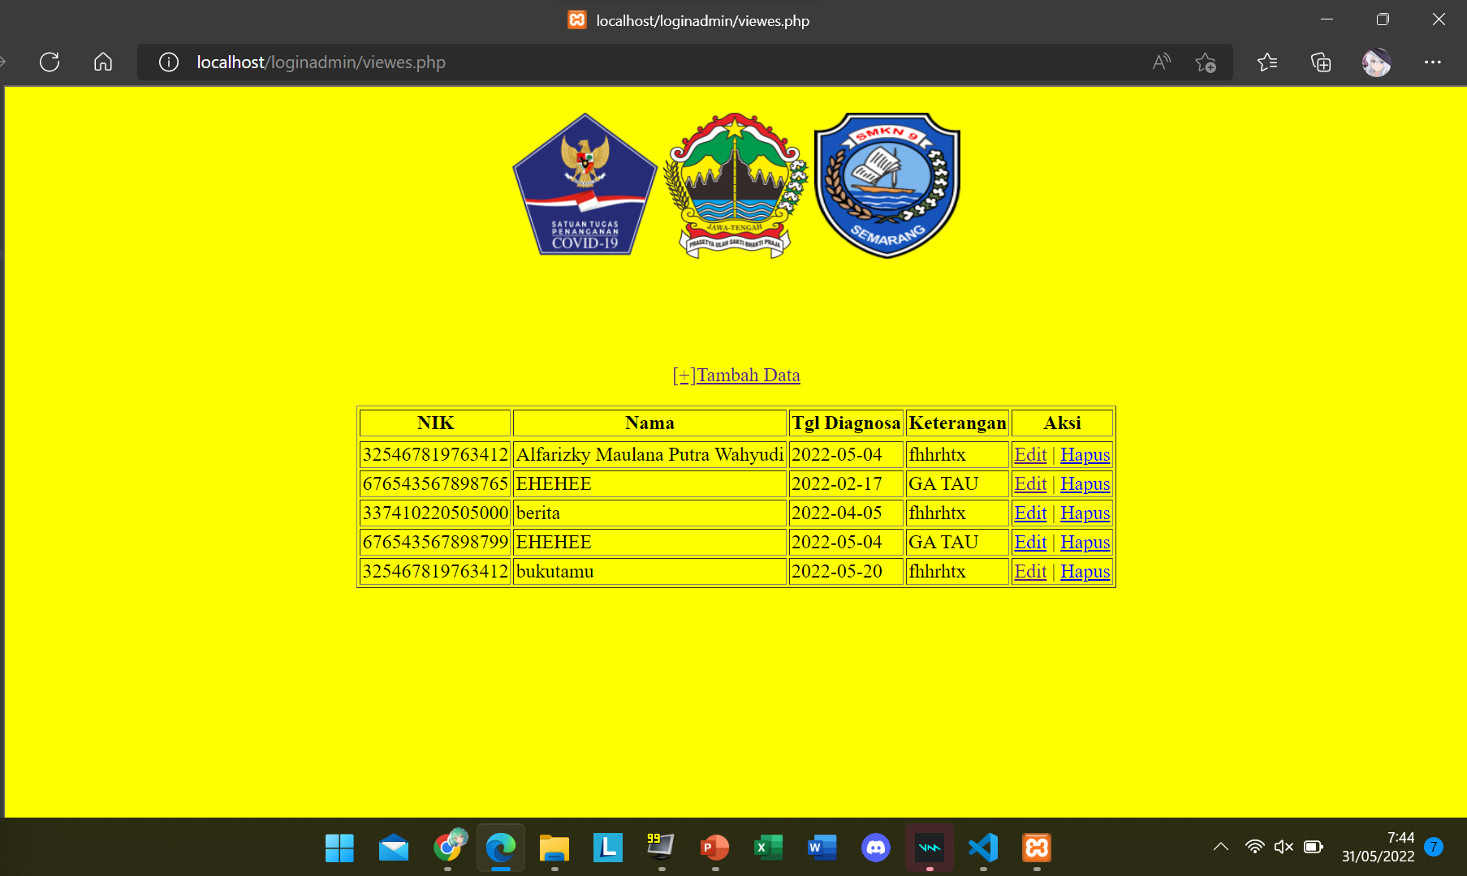
TAMPILAN HOME

Slide 11
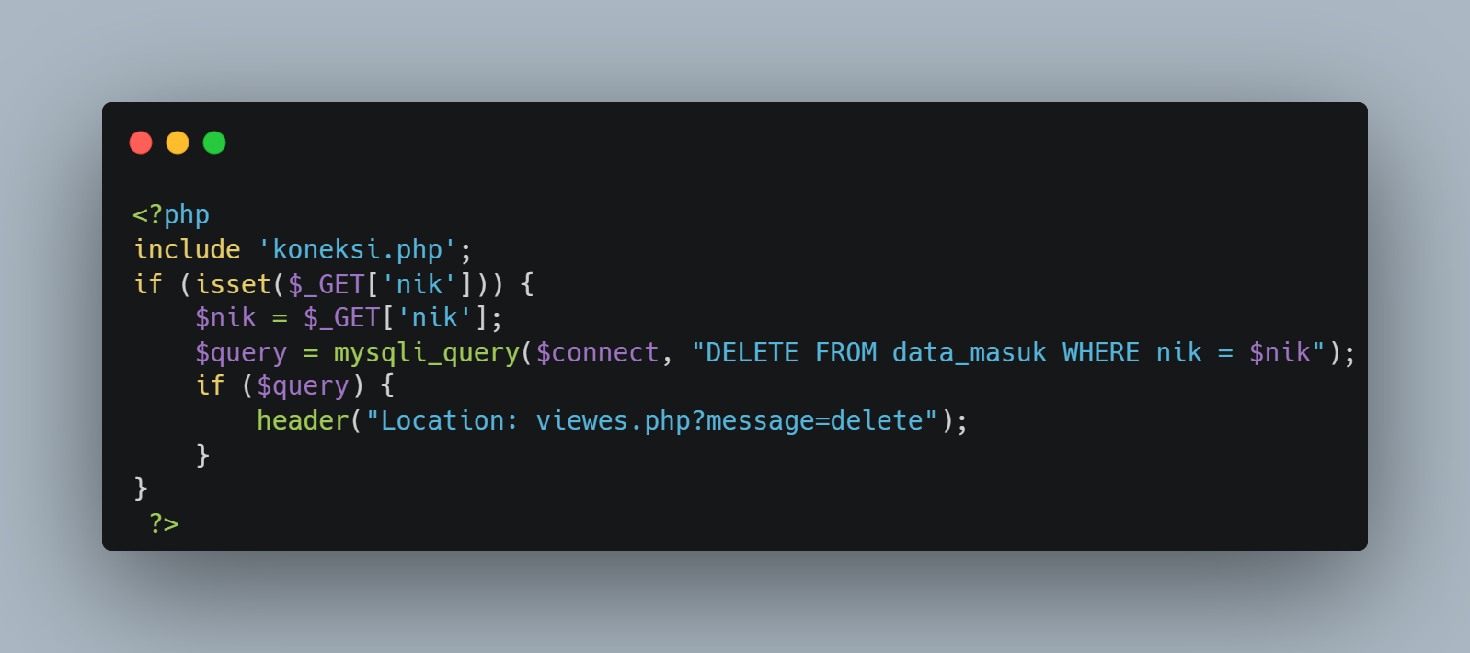
SCRIPT DELETE COVID

Slide 12

TAMPILAN EDIT DATA COVID

Slide 13
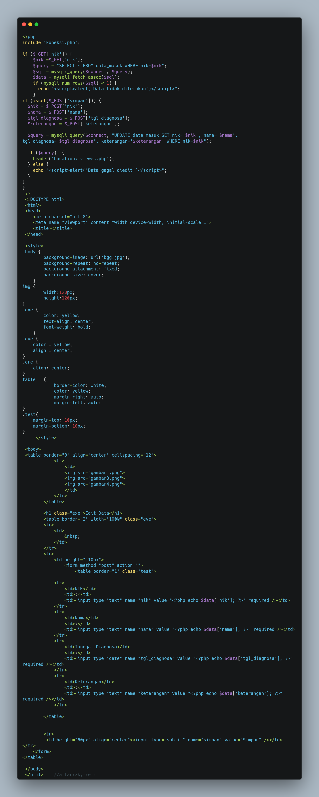
SCRIPT EDIT DATA COVID

Slide 14
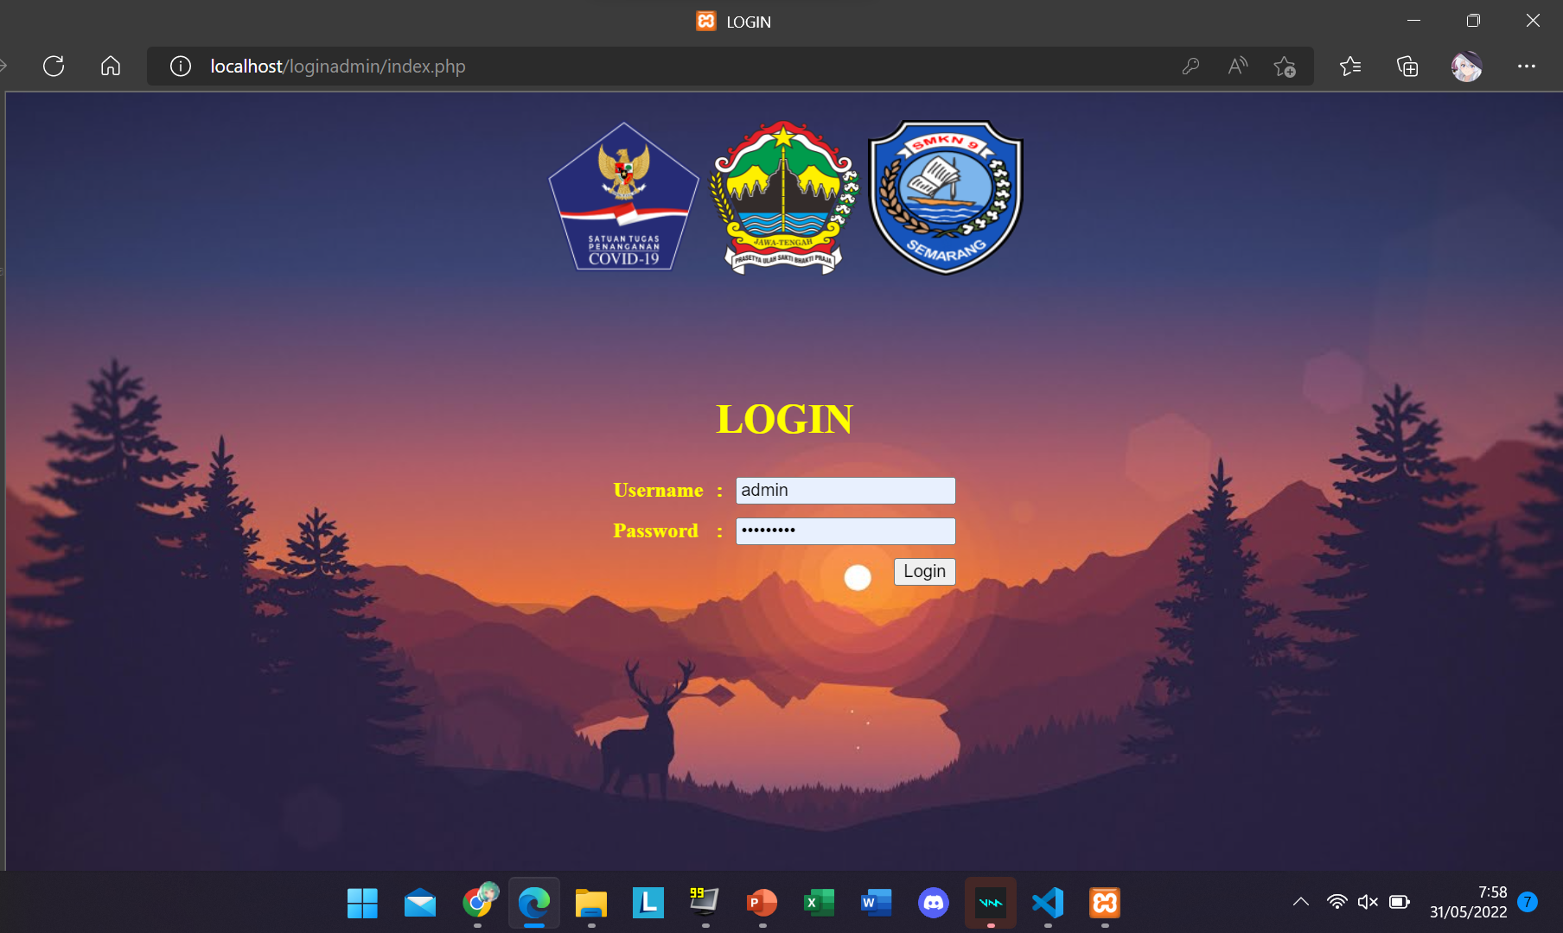
TAMPILAN LOGIN

Slide 15
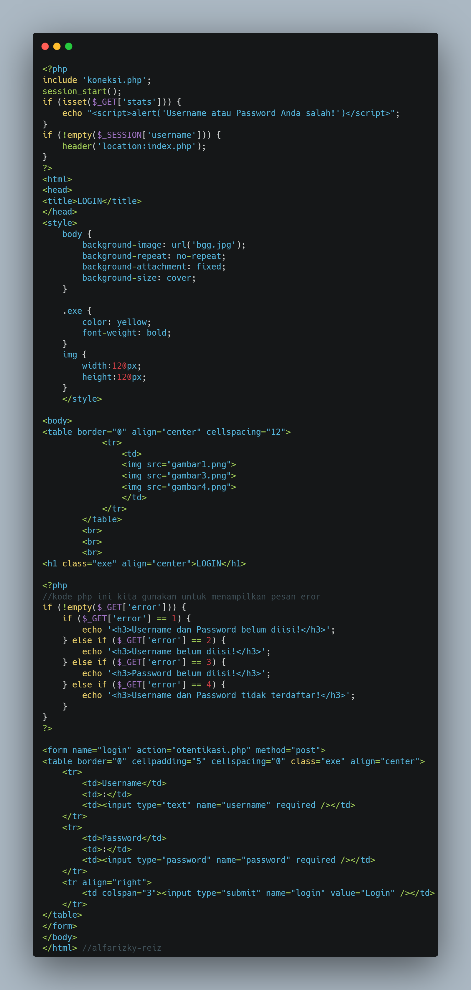
SCRIPT BUAT LOGIN

Slide 16
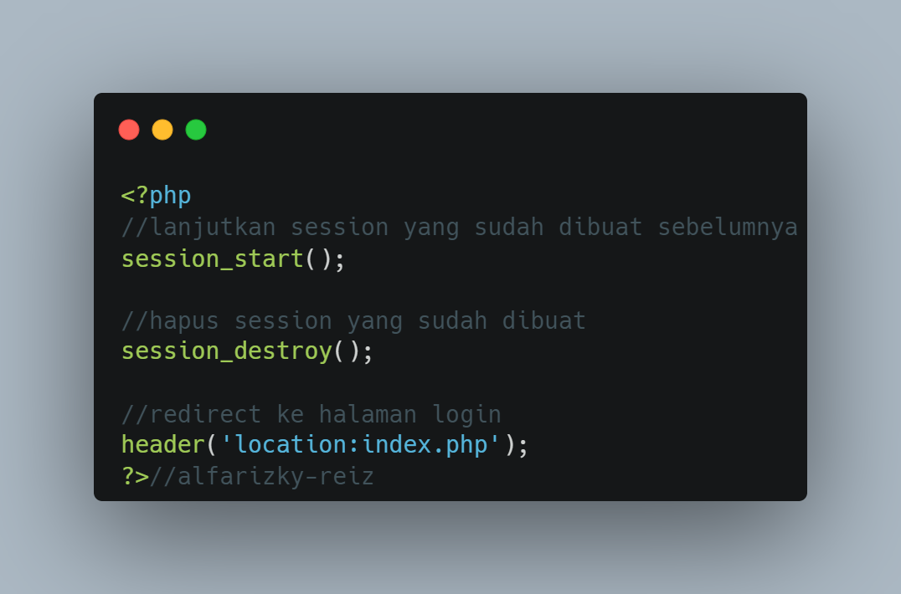
SCRIPT LOGOUT

Slide 17
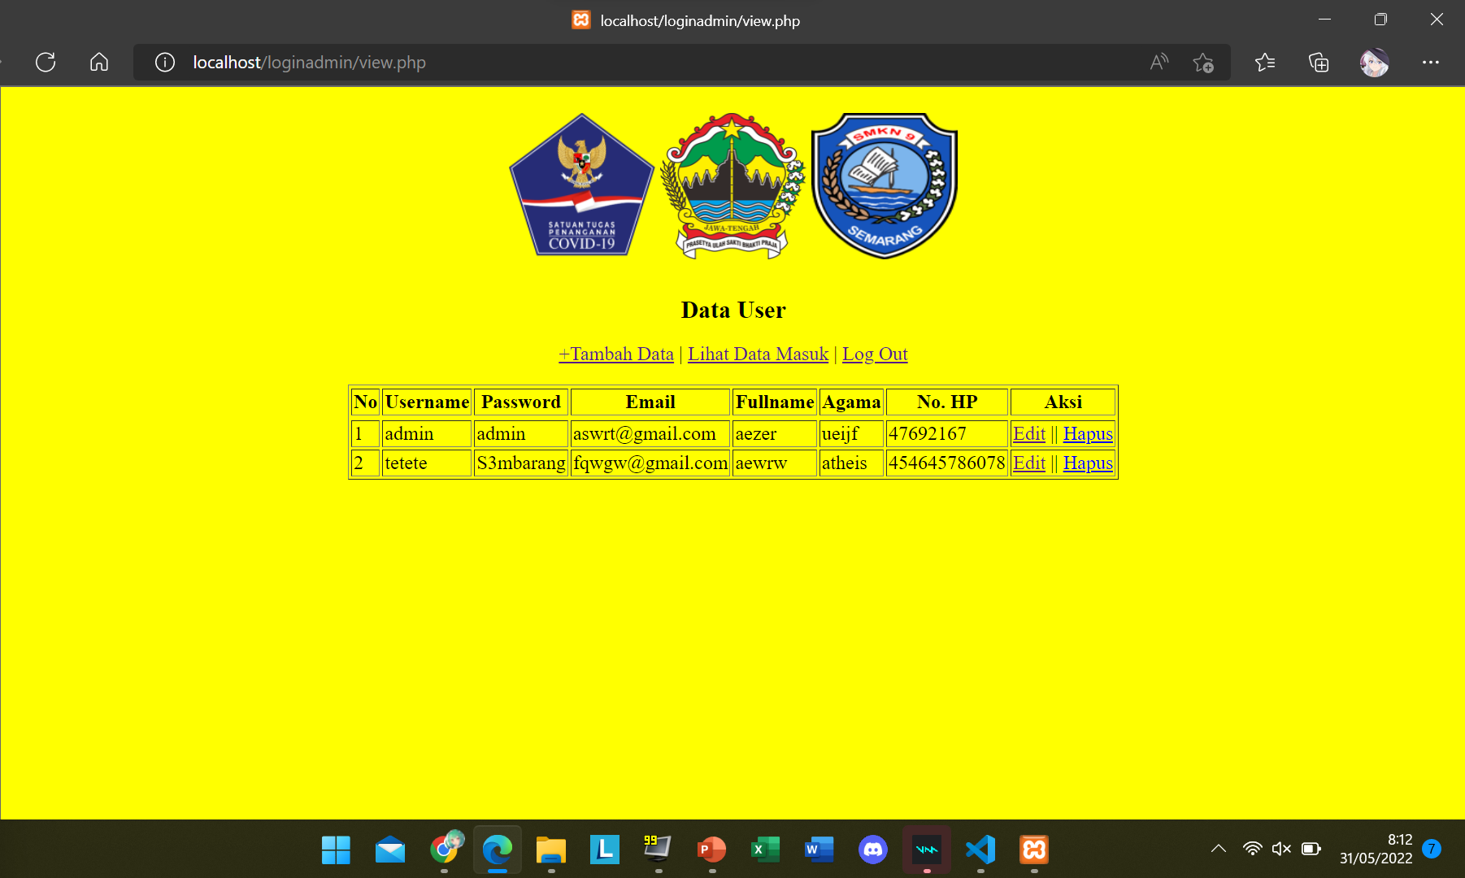
TAMPILAN DATA USER

Slide 18
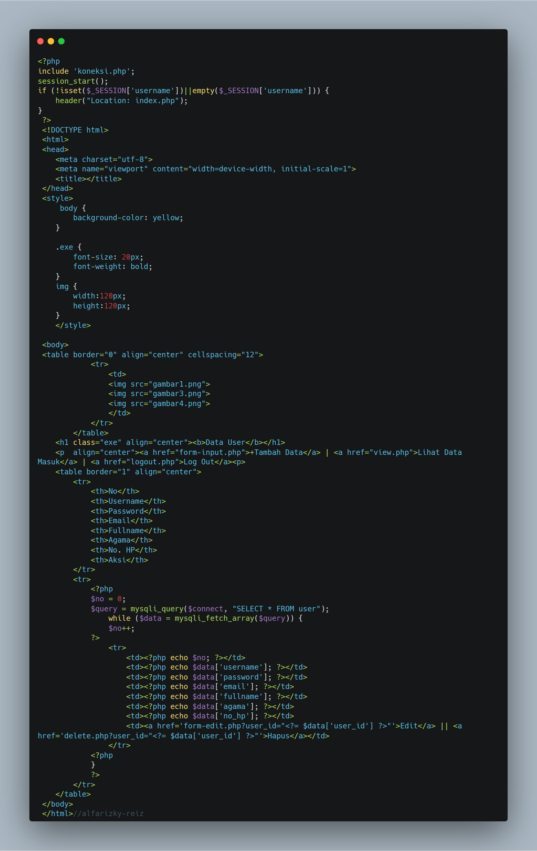
SCRIPT DATA USER

Slide 19
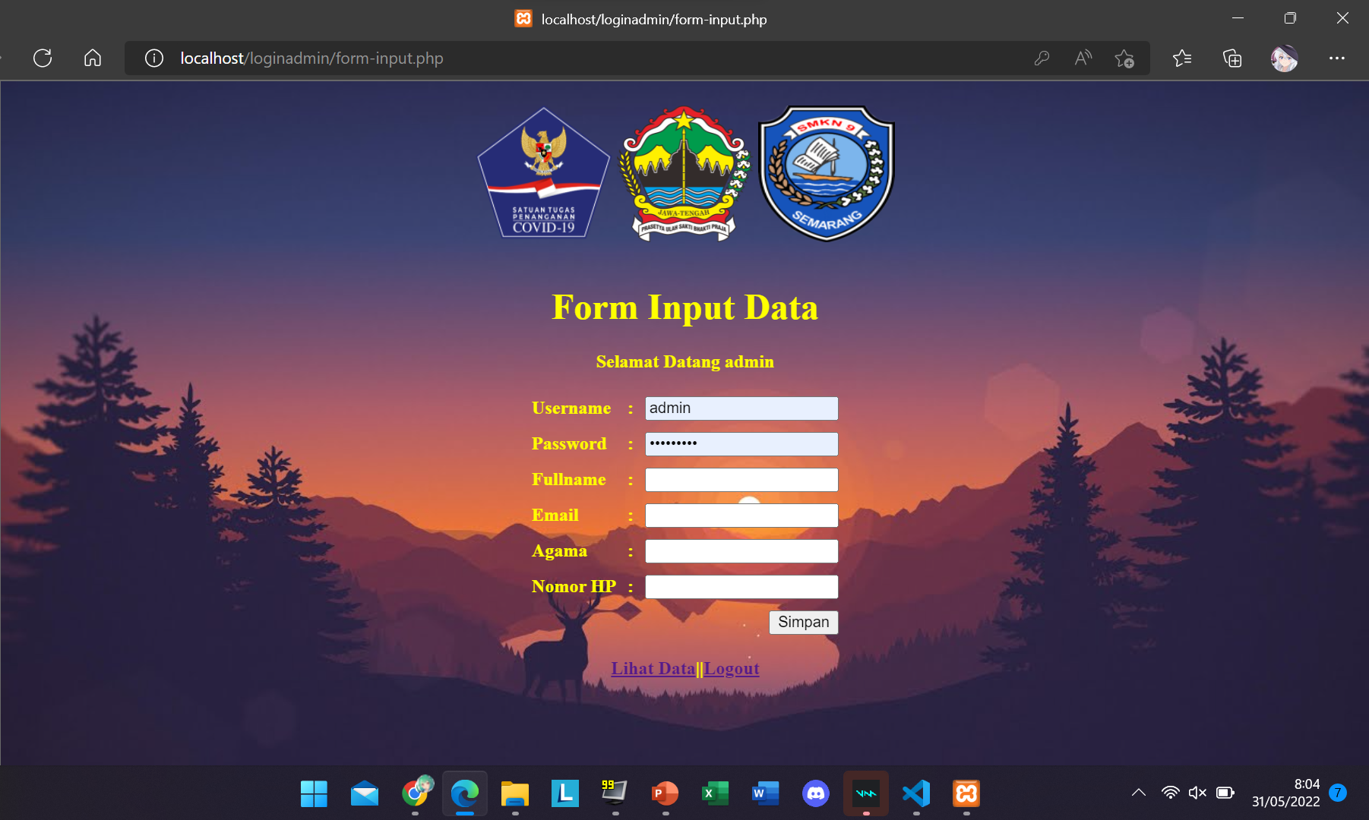
TAMPILAN FORM INPUT-DATA

Slide 20
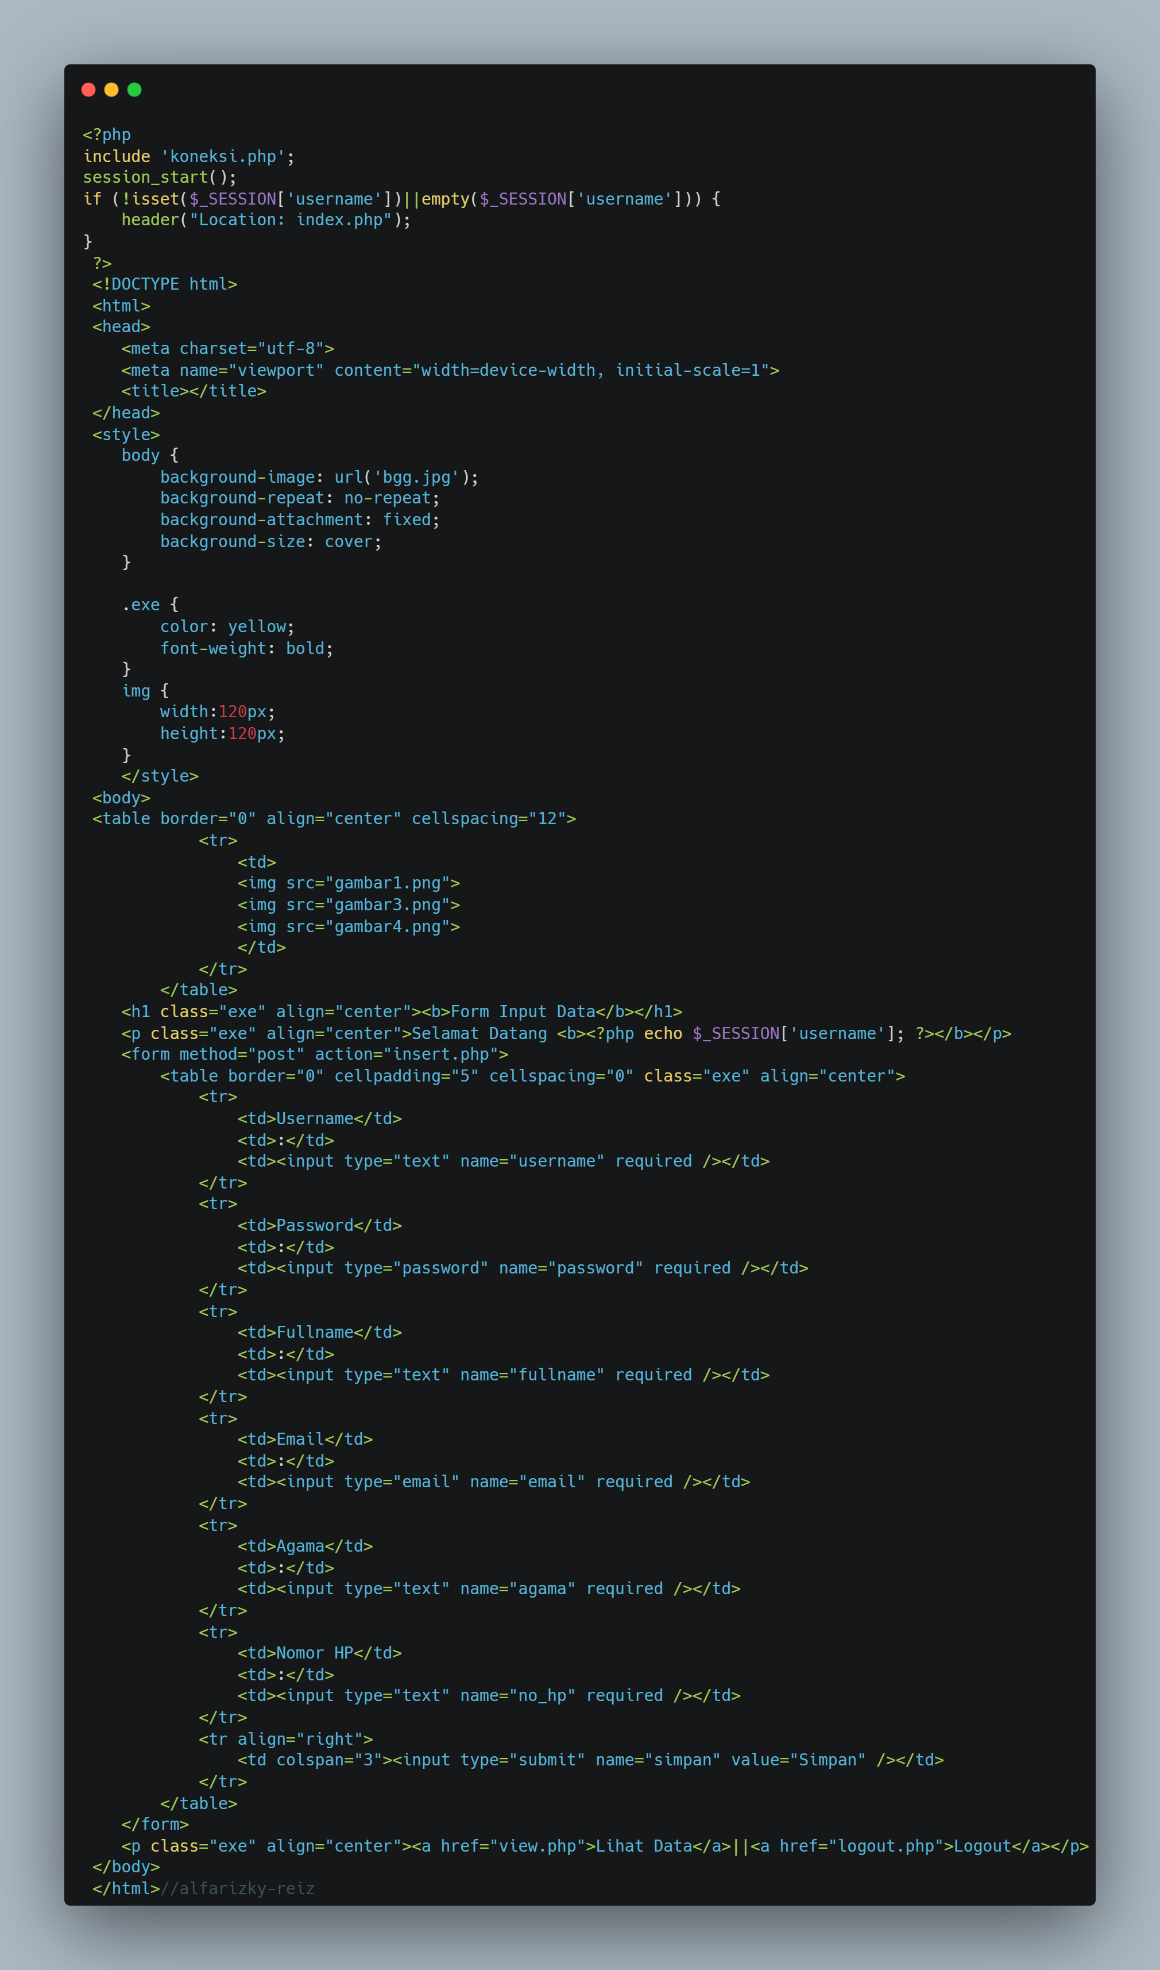
SCRIPT FORM INPUT-DATA

Slide 21
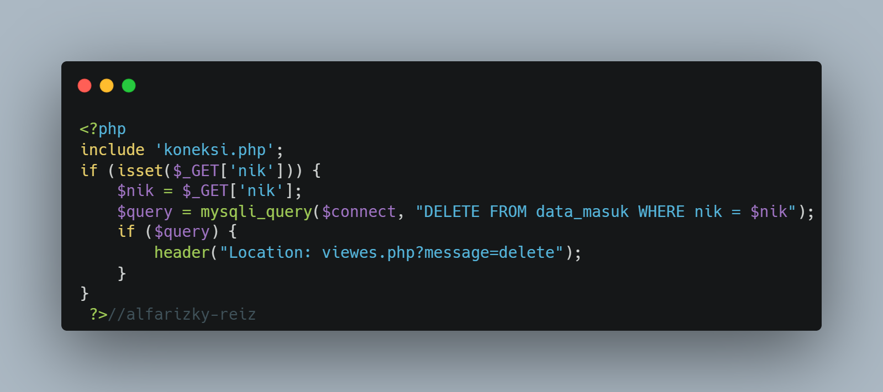
SCRIPT DELETE USER

Slide 22
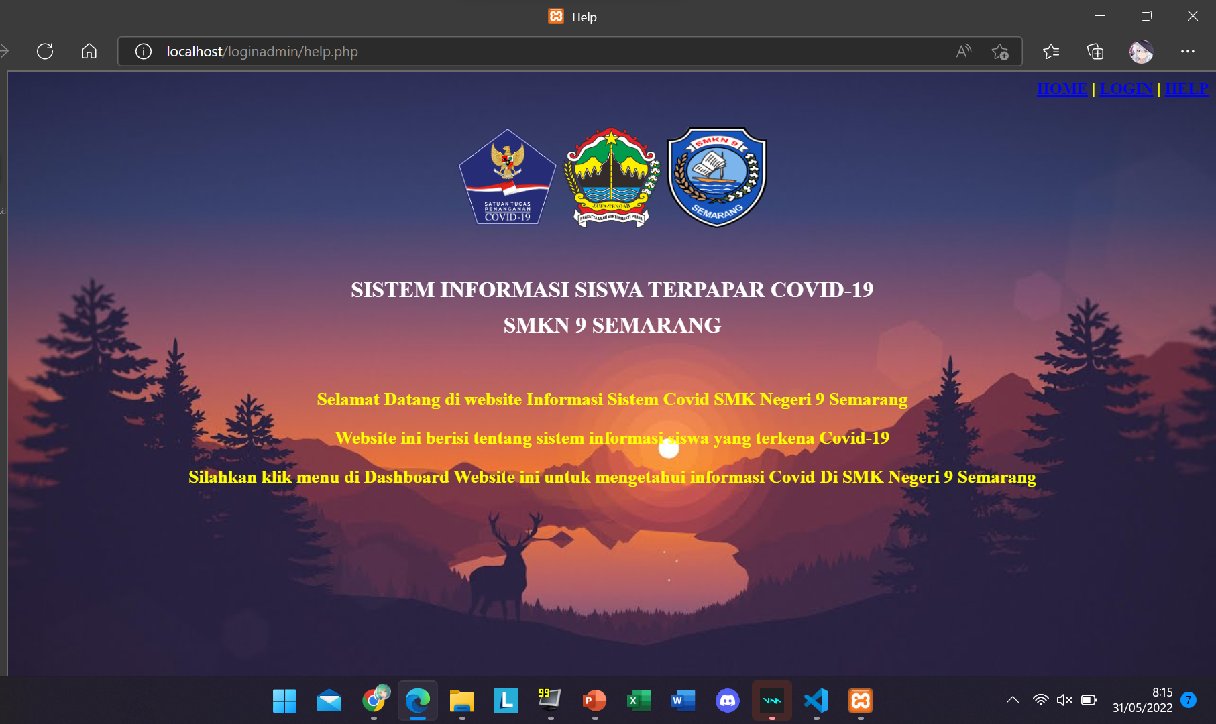
TAMPILAN HALAMAN HELP

Slide 23
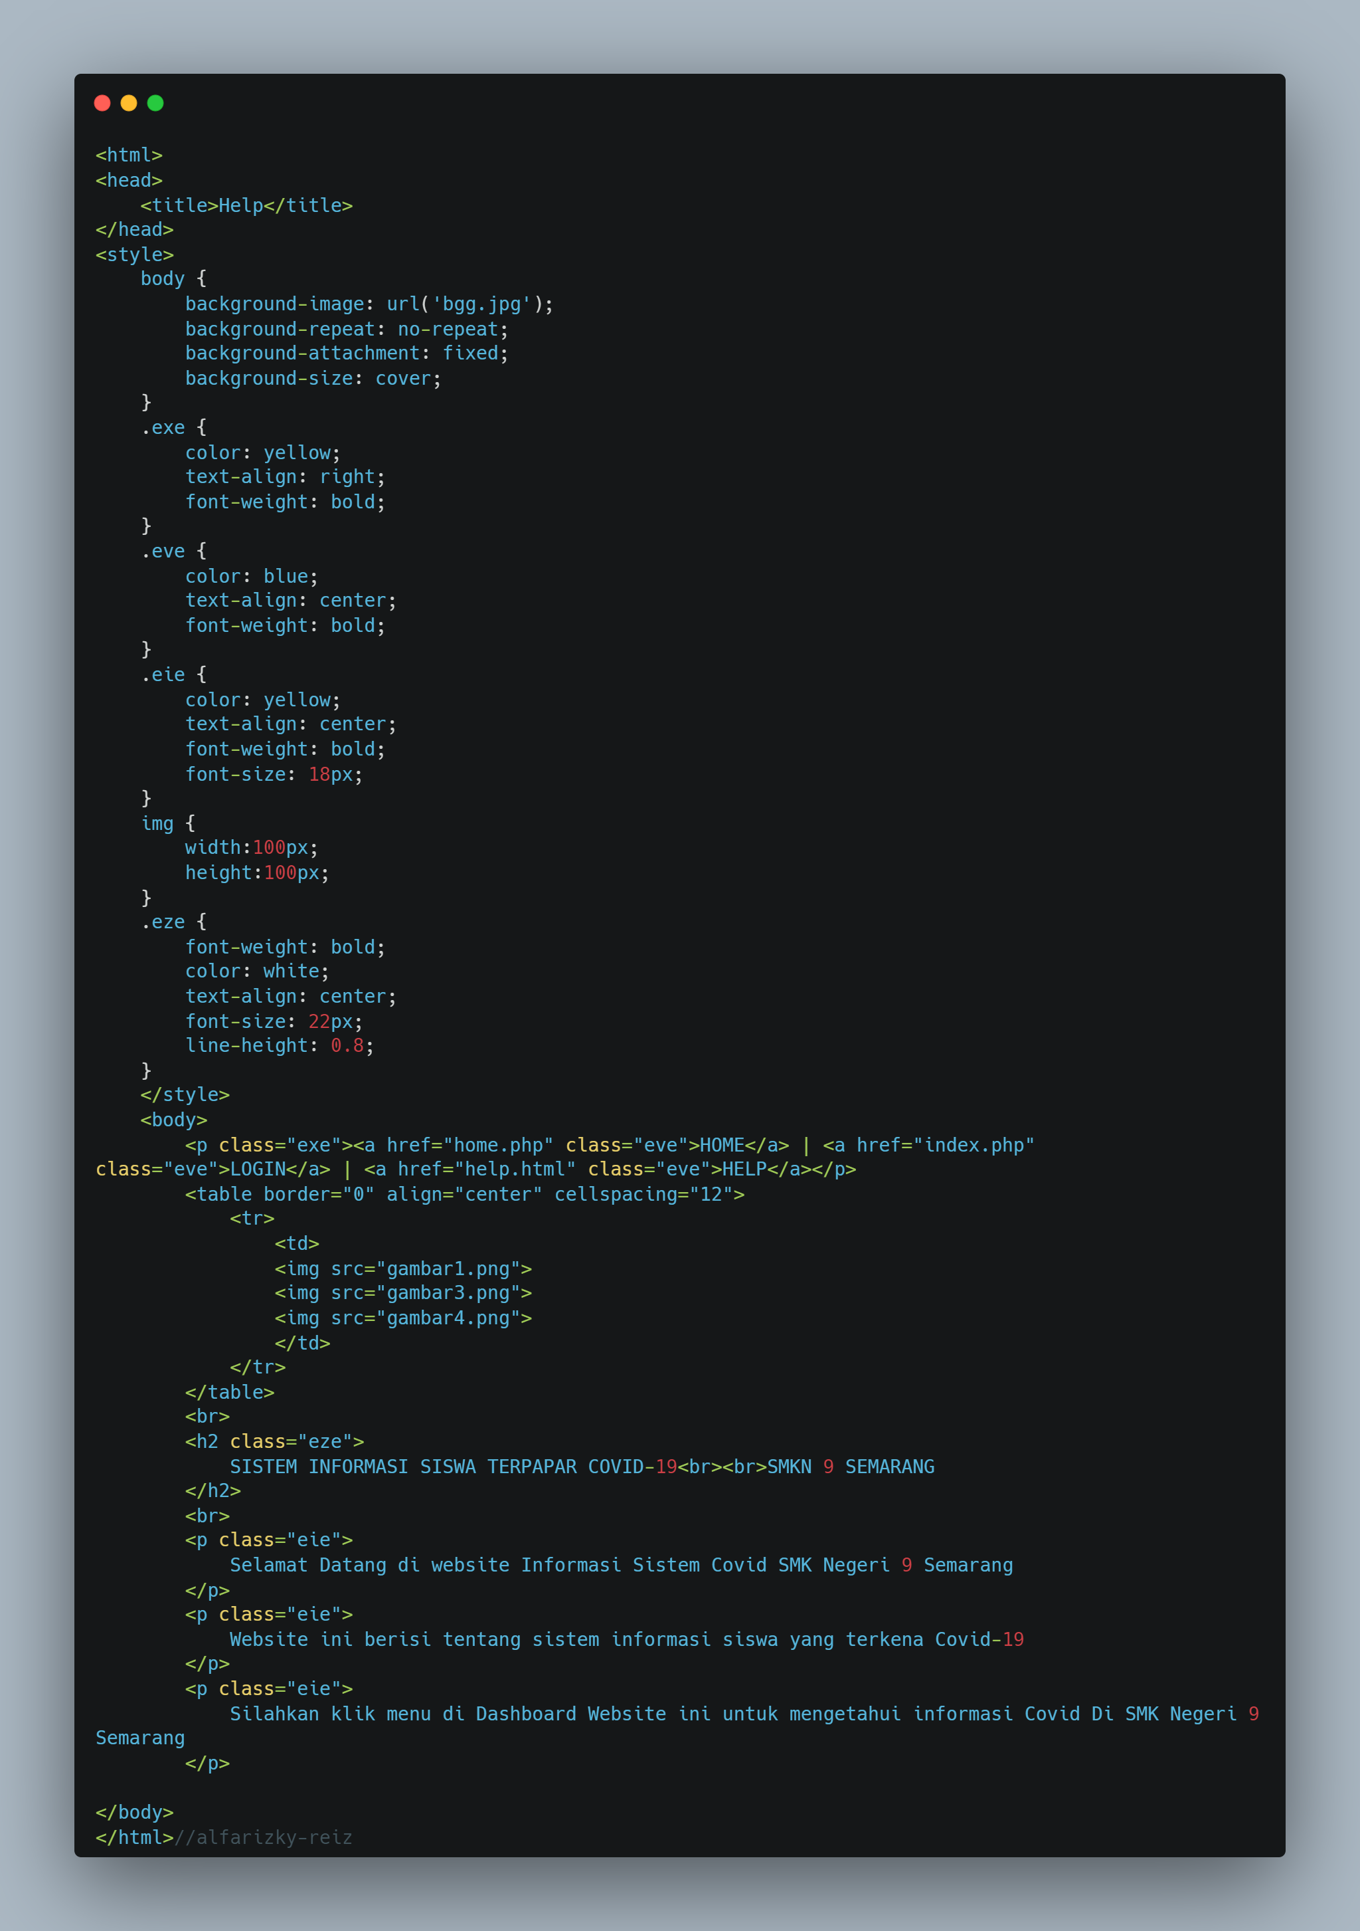
SCRIPT HELP

Slide 24
Awesome words

